Slide 1
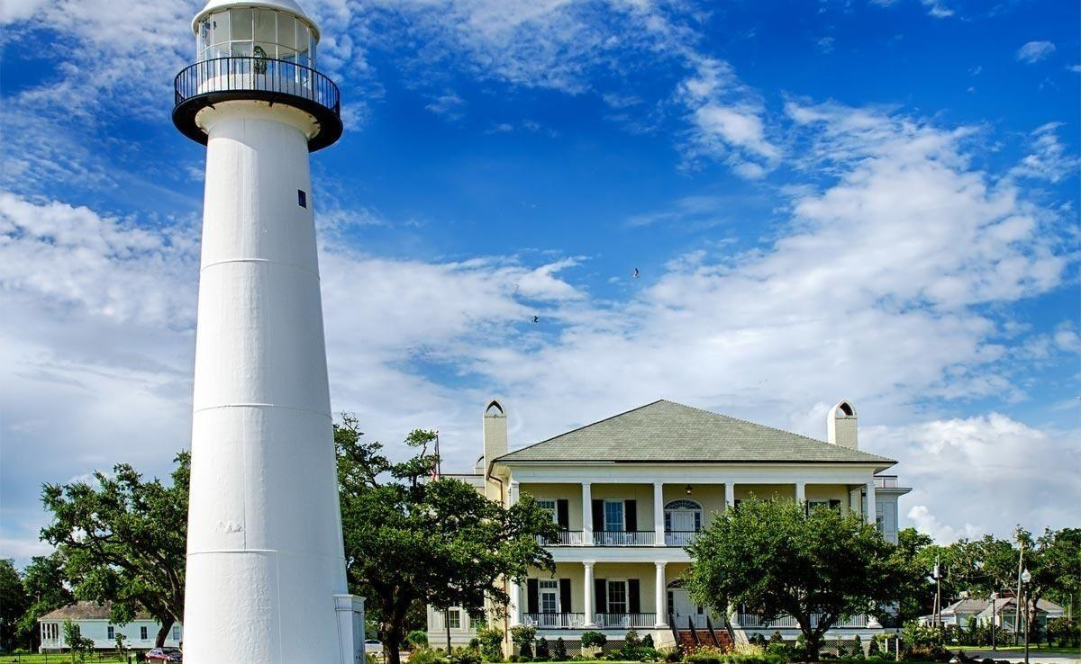
Mississippi Windstorm Underwriting Association
History & Rules and Processes 2022

Slide 2
BOARD OF DIRECTORS
3 agents with at least 10 years experience
2 must be residents of the Coast
1 must not be a resident of the Coast
5 assessable insurers
Insurers that are authorized to write and engaged in writing property insurance within Mississippi on a direct basis.
2 Coast business leaders
The State Treasurer
11 Board Members

Slide 3
MWUA’s Mission
“Assure an adequate market for wind and hail insurance in the coast area of Mississippi.”
Protect policyholders state-wide from unreasonable windpool surcharges.
Avoid damaging the state-wide market for property insurance.
Encourage better building standards and land use in the coast area in order to mitigate wind losses and depopulate the Windpool.
While accomplishing these goals, try to avoid high rates thus helping the Coast economy revive.

Slide 4
Post Katrina Legislation
HB 1500
Signed into law changing MWUA .
HB 444
Signed into law amending elements of HB 1500 provisions effective 7-1-2019 with Impact to Admitted Company Assessments effective 2020.
HB 451(2022 Legislative Session)
Removed the repealer so that the MWUA would continue to receive a portion of the non-admitted fee.
Diverted a minimum of $4million of the NAF from MWUA to other funds but guarantee at a minimum that the MWUA would no matter what get 60% of all NAF collected.

Slide 5
MWUA CHANGES
Geographic rating tiers – 5 rating zones
Flood requirement for A and V zones
Optional Deductibles – (Minimum 2%, 5%, 10%, 15% & 20%)
Fully Earned Premium Rule – Prevent Short Term Purchase
No Servicing Carrier – Plans system/Plans staff administer
Enhanced exposure data gathering to improve modeling
data – Update Inspections – Insurance to Value UW
Commercial Deductible Change- Application of Deductible
Discontinue MWUA Mitigation Program/ Now IBHS Applies
Amended Mandatory Evacuation Coverage
Manufactured/Mobile Homes – Fire Marshal Insp. Required
New Coverage Forms –Dwellings/Mobile Home RCV/ACV
Dwelling RCV policies include Fortified Roof Coverage

Slide 6
MWUA Exposure 2005 to Current
Peaked 2011
46,406 policies
$7.24 billion insured
August ’05
16,155 polices
$1.8 billion insured
September 2022
12,534 policies
$2.385 billion insured

Slide 7
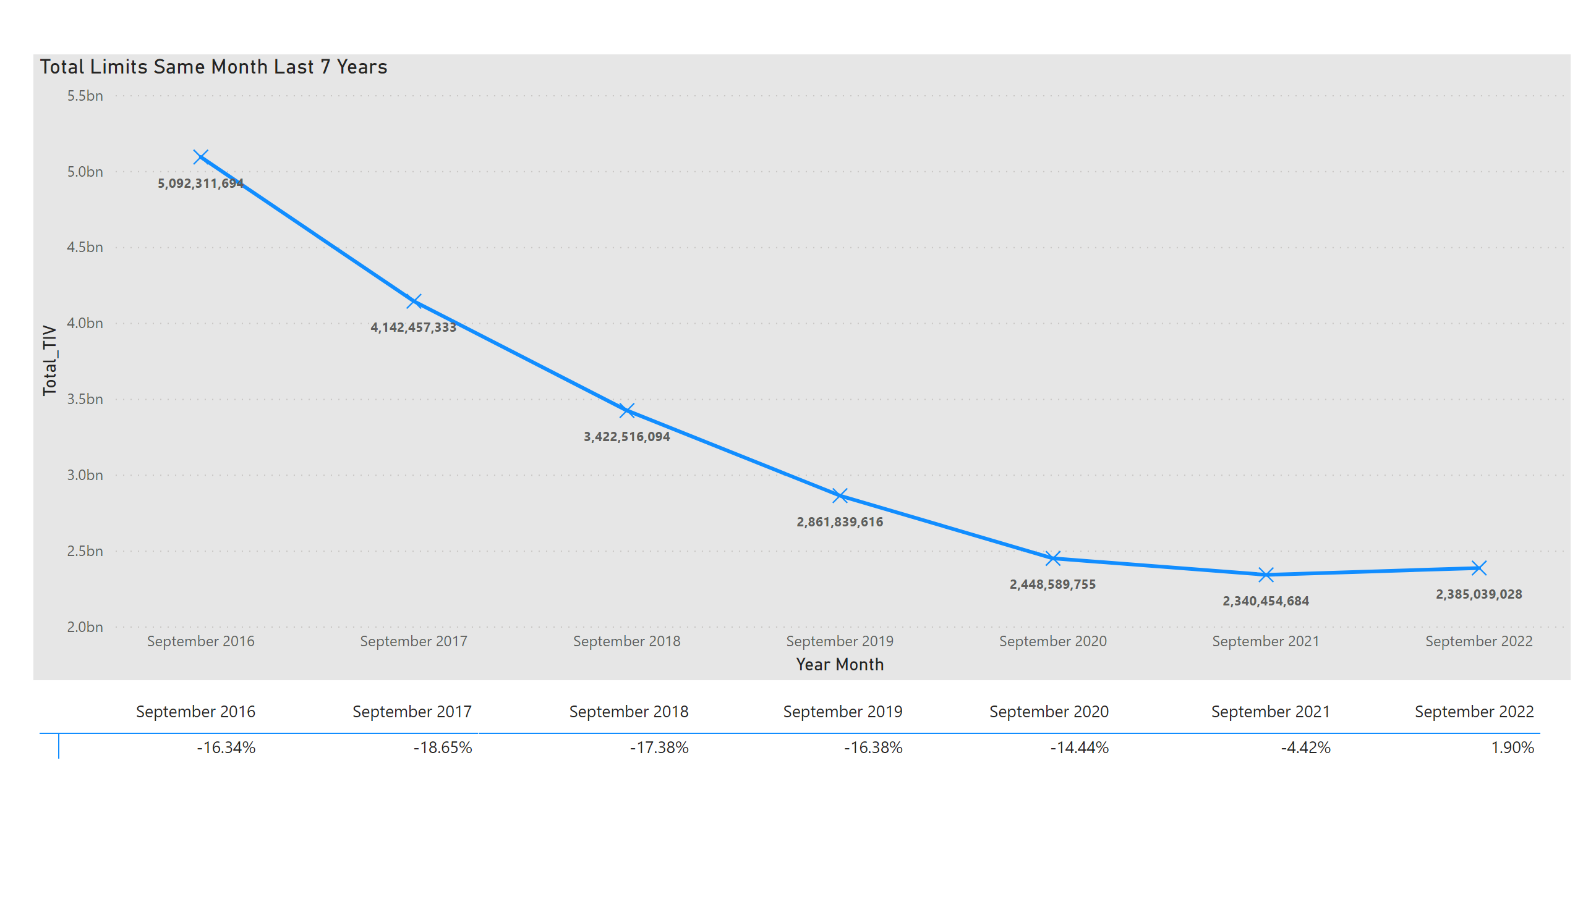
Total Limits In Force 7-year Trend
Notes:
pivotTable
No alt text provided
Total Limits Same Month Last 7 Years
No alt text provided

Slide 8
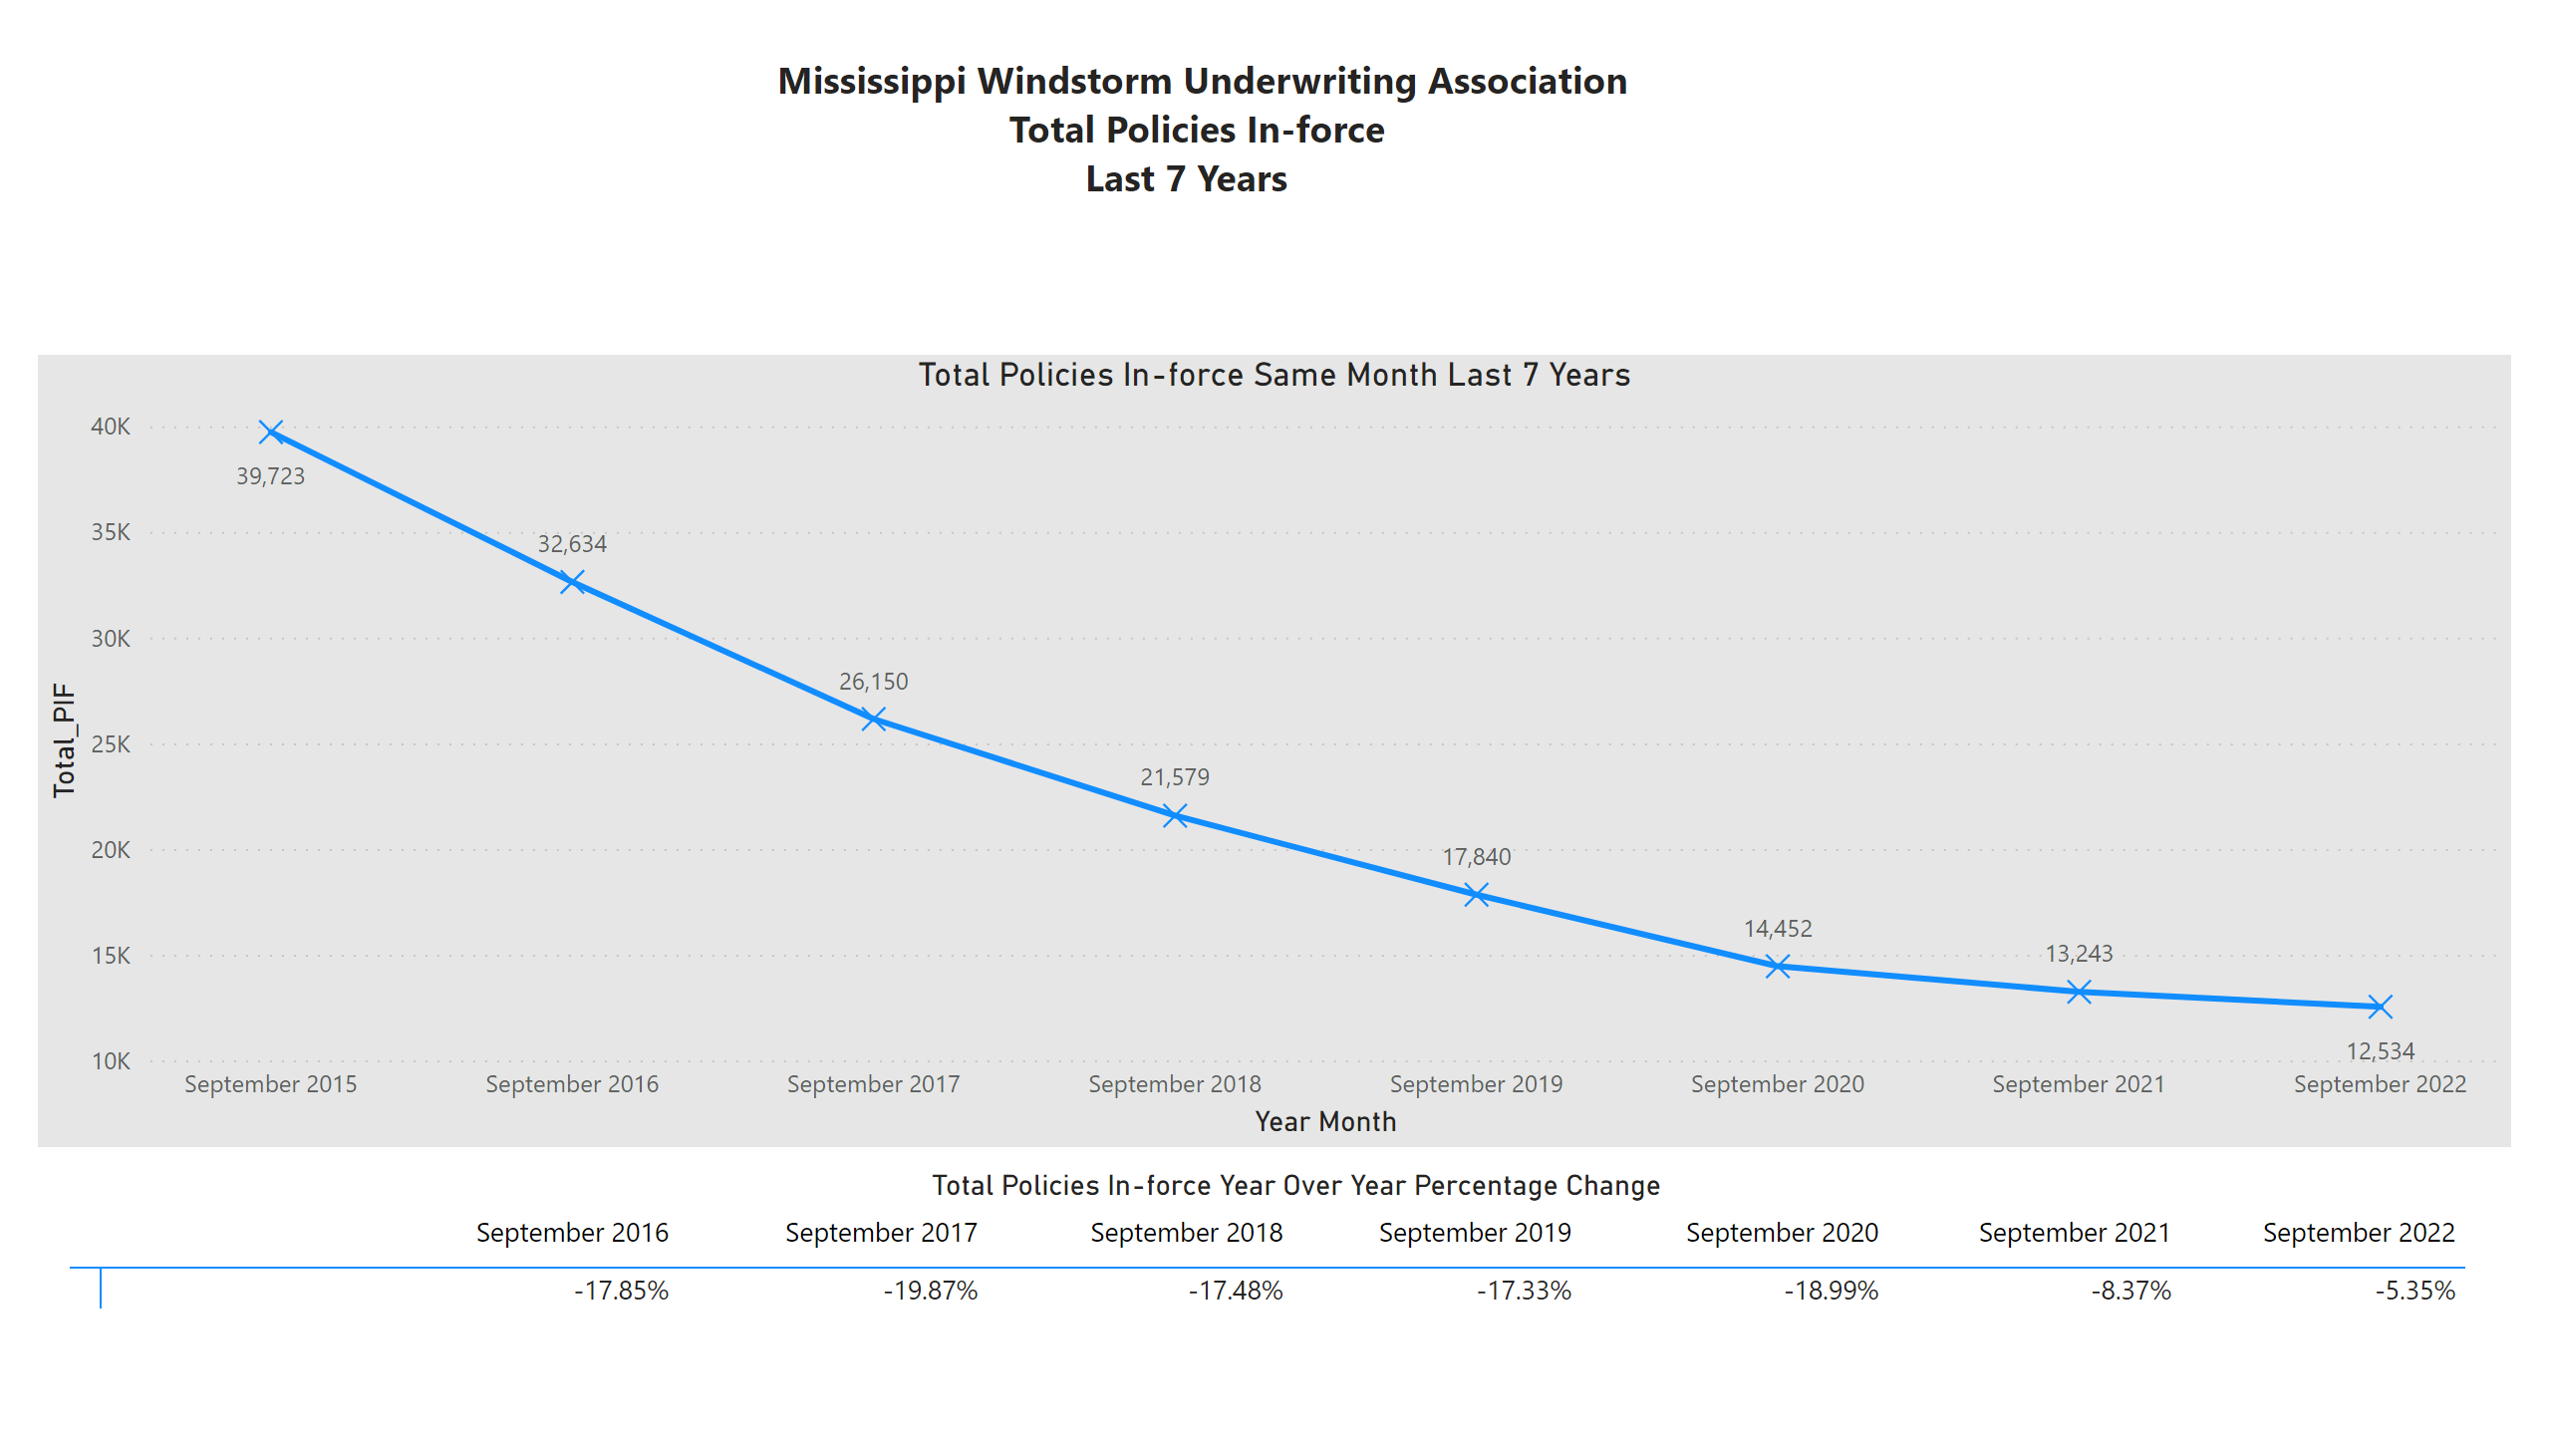
Policies In Force 7-year Trend
Notes:
Total Policies In-force Same Month Last 7 Years
No alt text provided
textbox
No alt text provided
Total Policies In-force Year Over Year Percentage Change
No alt text provided

Slide 9
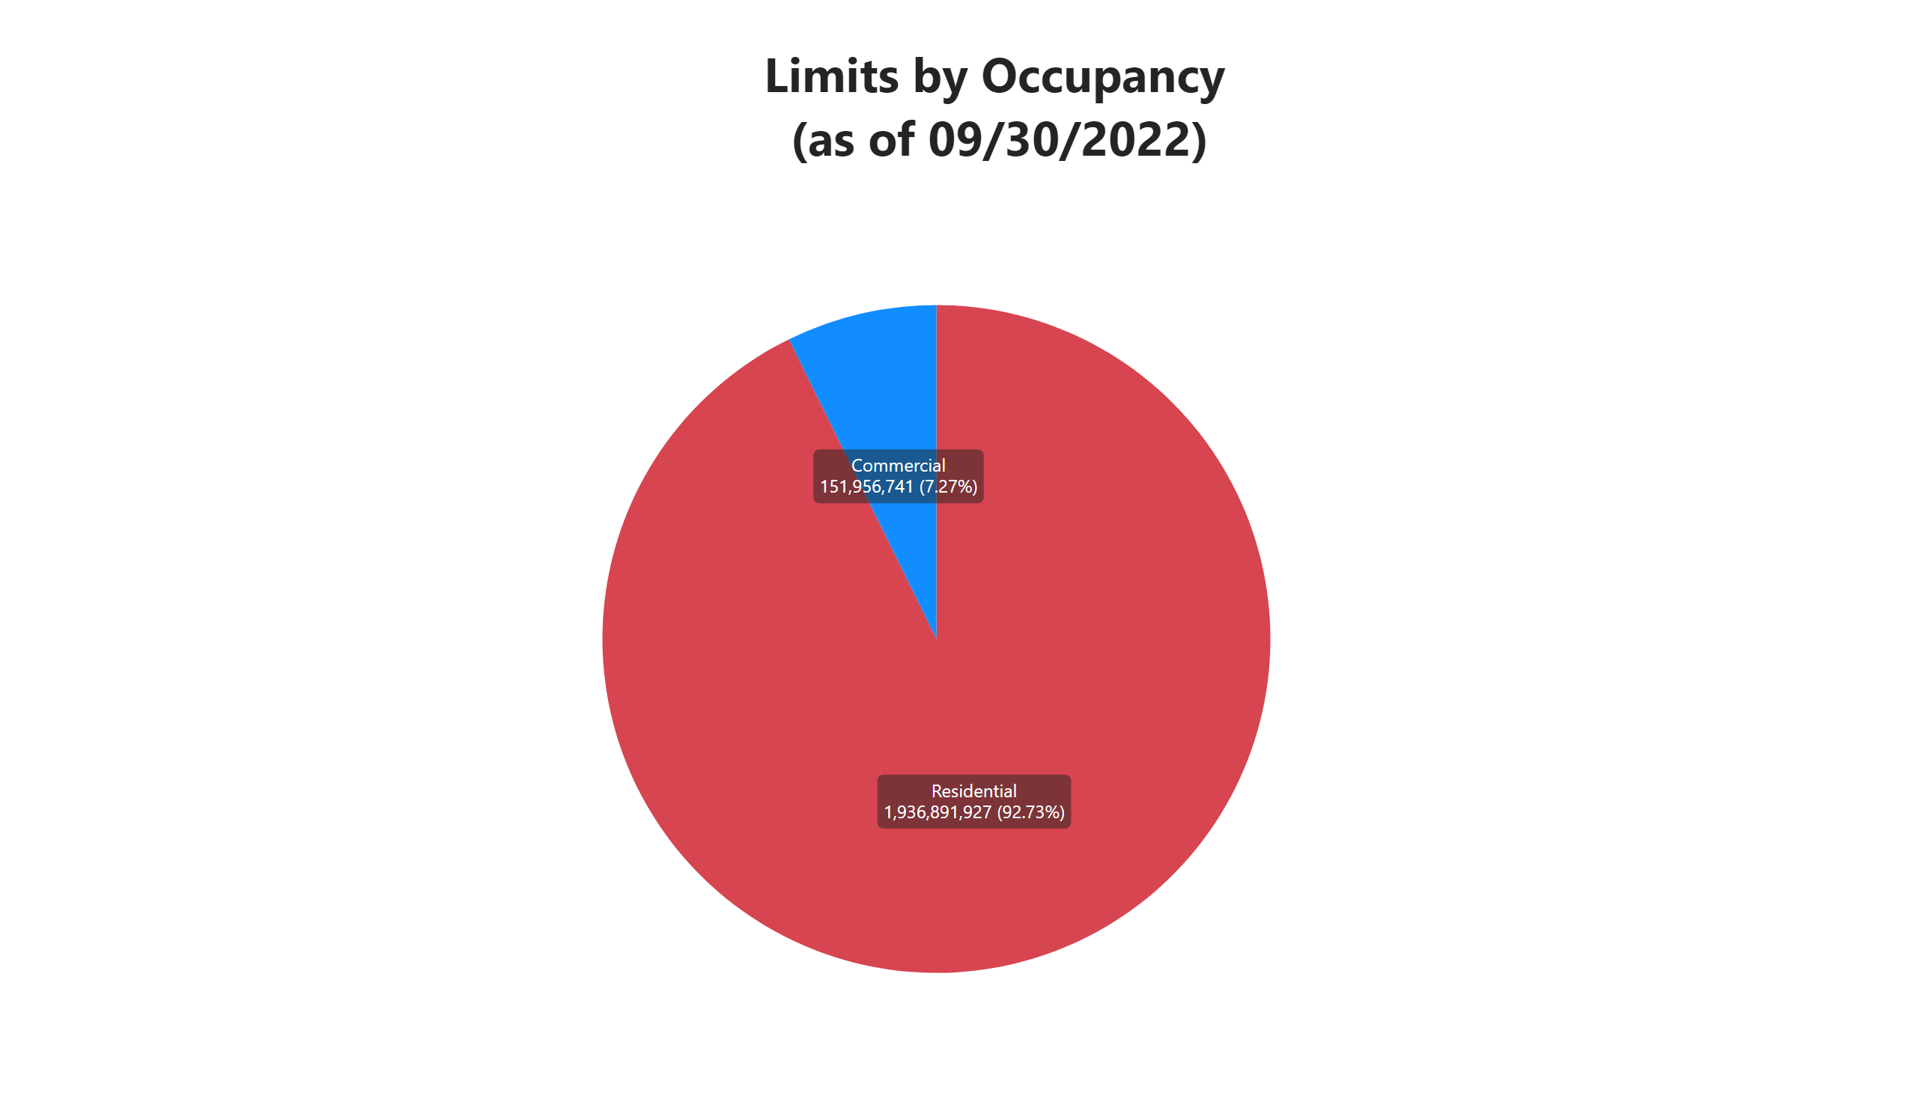
Limits By Occupancy
Notes:
Limits by Year Built (as of 09/30/2022)
No alt text provided
textbox
No alt text provided

Slide 10
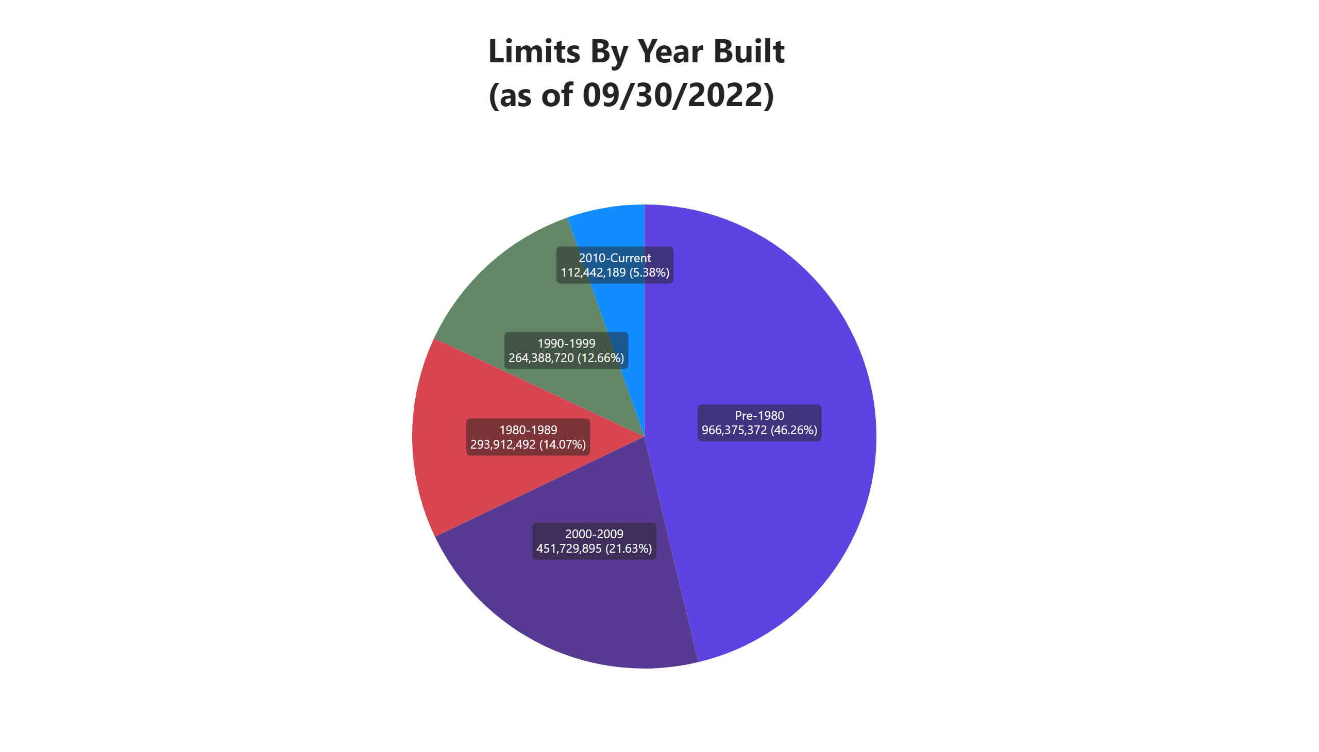
Limits By Year Built
Notes:
Limits by Year Built (as of 09/30/2022)
No alt text provided
textbox
No alt text provided

Slide 11
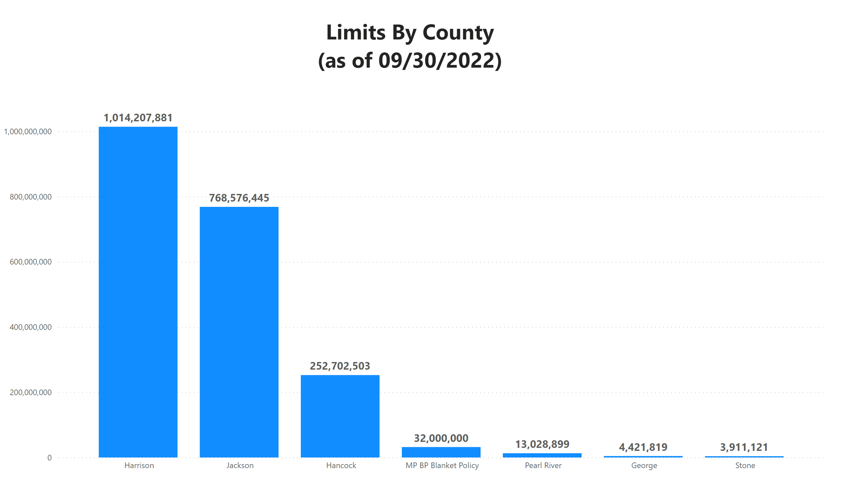
Limits By County
Notes:
Limits by Year Built (as of 09/30/2022)
No alt text provided
textbox
No alt text provided
textbox
No alt text provided

Slide 12
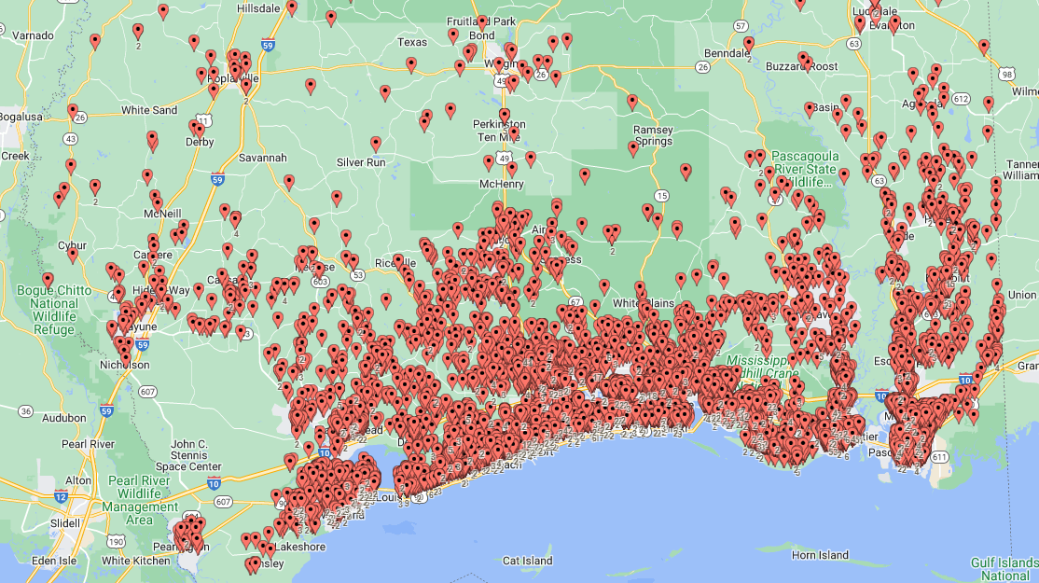

Slide 13
MWUA KATRINA LOSSES
16,155 policies in force
18,154 claims
$1.8 billion insurance in place
$720 million losses – 40% of Insured Limit
$175 million 2005 reinsurance in place
The remaining $545 million in MWUA losses were assessed to and paid by admitted insurance companies.

Slide 14
HURRICANE KATRINA FUNDING CHART
2022 MWUA CATASTROPHE FUNDING CHART
% of Total $2.3 Billion Limits
 | Unlimited Assessment to Statewide Policyholders
 | $138 Million Assessment to Insurance Companies Non-recoupable
 | $153 Million MWUA Reserve Funds
 | 250 Million Reinsurance Purchased
 | 170 Million Reinsurance Purchased |  | 30 Million MWUA Funds
 | 50 Million MWUA Reserve Funds
 | 15Million Reinsurance Purchased | 10M MWUA Funds
 | 25 Million MWUA Reserve Funds
% of Total $1.8 Billion Limits
Unlimited Carrier Assessment
$535 Million MWUA Carrier Assessment
175 Million Reinsurance Collected
10 Million MWUA Carrier Assessment
Katrina = 40%
$920M Claims
36.43%
$838M Claims
40.0%
$720M Claims
30.56%
$703M Claims
23.91%
$550M Claims
$300M Claims
4.34%
$100M Claims
10.28%
$185M Claims
2.17%
$50M Claims
0.56%
$10M Claims
1.08%
$25M Claims

Slide 15
Rate Change History
2006 +90% post Katrina rate increase (indicated rate
need was over 300% but was offset by 50 million in grants)
2008 -14.2% (in recognition of grants
received for the purchase of
reinsurance).
2013 +3.2% Dwelling, +5% Commercial
2021 +15% Dwelling Zones A & B, +10%
to Wind Resistive Dwellings all Zones

Slide 16
WHY Did the Dwelling Forms Change Effective 2-1-2020 (RCV and ACV Option)?
* Provide Value Certainty at Time of Loss
* Remove Coinsurance Penalties
* Limit Disputes at Time of Loss
* Further Clarify Insured Intent RCV/ACV
* Updates to Simplify Language
* Updates to stay current to ISO language
* Goal -Sufficient Coverage for an Insured’s Loss

Slide 17
Inspection Variance Department
Order
Order inspections of existing policies
Process
Process inspection results
Disclose
Disclose suggested minimum policy limits based on inspection
Review
Review evidence from agent in support of different minimum limits
Offer
Offer potential compromise when needed.

Slide 18
How we estimate minimum limits
Software: 360Value (ISO 360)
Cost of building materials algorithm updated quarterly
Team of inspectors that visit each subject property to take multiple photos and measurements for entry into the valuation software.

Slide 20
Inspection limitations to be aware of
Policy does not have current phone number for insured
People rarely answer unknown calls
Dogs, locked gates, debris, terrain
Unknown interior floor plans (especially on 2 story homes) and custom interior finishes
Additions to the home that the agent is not aware of

Slide 21
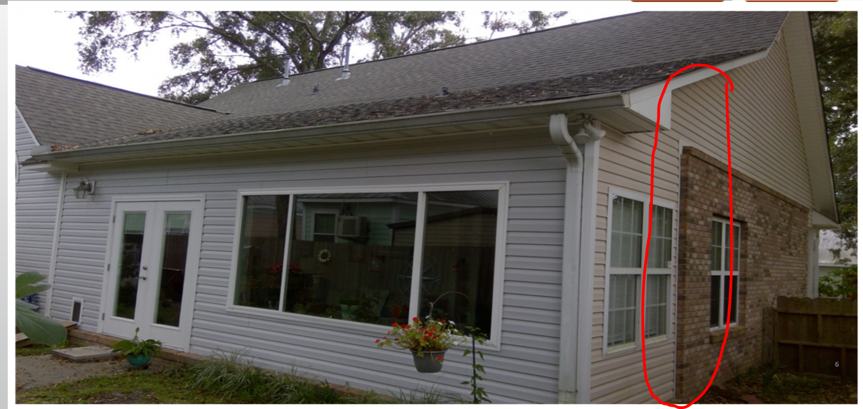
Possible addition to original floor plan?

Slide 22
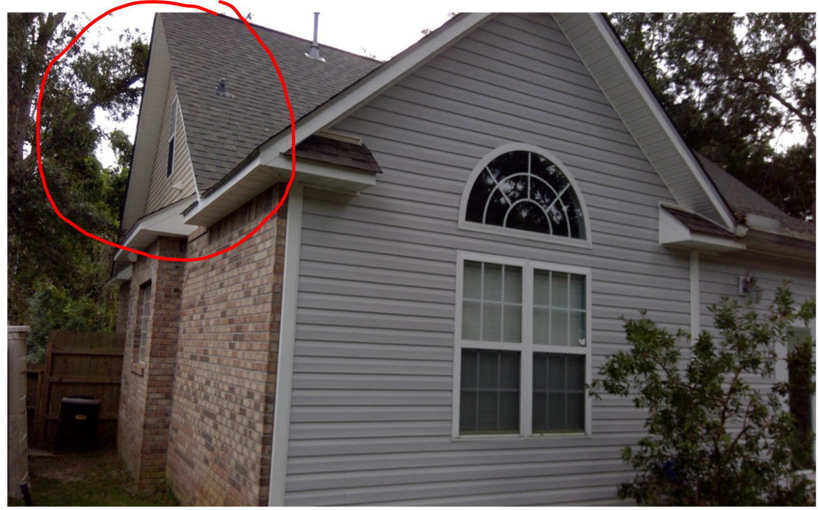
Finished living space?

Slide 23
Custom interior finishes

Slide 24
ITV letters
Existing Business
New Business
Visit
Visit property every 3-4 years
Disclose
Disclose minimum replacement cost estimate based on recent inspection as timely as possible.
Offer
Offer next annual quote at the disclosed suggested minimum limit.
Policy allowed to be written using minimum formula associated with the Quality Grade disclosed on application.
Visit home for inspection asap
After inspection, ITV letters disclosed (all interested parties) to show suggested minimum using data gathered on site.
If no response or action, policy will be increased to estimated minimum, 30 days post-disclosure.

Slide 25
Appropriate Coverage Limits

Slide 26
Policy Limit Options
Actual Cash Value
Replacement Cost Value
Uses factors such as age, condition of structure to factor depreciation into minimum required limit.
Lower premiums
Does not ensure payment for the home to be fully restored in a total loss.
Based on current market price of comparable building materials.
Higher premiums
Intended to replace/restore home to new construction levels.

Slide 27
Allow agent to participate in Limit Debate
We disclose limit alteration requirements in advance to allow the commissioned agent to dispute our findings on behalf of their client.
We will review evidence and offer concessions when reasonable.
Appraisals, Tax rolls, blueprints, builder plans etc.

Slide 28
Explaining Property Values to Insureds:
Market Value $105,000
Replacement Cost $440,000
Actual Cash Value $225,000

Slide 29
Explaining Property Values to Insureds:
Market Value $319,000
Replacement Cost $120,000
Actual Cash Value- $80,000

Slide 30
Total Loss Recovery factors: Fire vs Wind event

Slide 31
Should I have the same policy coverage limit on both my Fire and Wind policies?
Fire Loss
Wind Loss
Likelihood somewhat influenced by geographical factors
Higher risk of large-scale event impacting large market areas, and more susceptible to surge pricing.
Higher likelihood in general
Smaller impact in overall scale, less chance of surge pricing of materials.

Slide 32
Ensuring your customer is taken care of
Customer:
Agent:
Price driven mindset: Affordable insurance premium
Adequate coverage to satisfy minimum mortgage requirements
Recover from loss scenarios
Applications that accurately represent the individual’s risk.
Explain the policy intent and limitations.
Knowledge of cost of building materials.
Focus on not only offering low premiums but also ensuring the customer can replace the home fully.
Maintain current contact information and have a secondary contact on file.

Slide 33
Our common goals
Supplement the Voluntary Market and provide coverage to those who may not qualify for standard policy coverage.
Ensure the risk is insured adequately for policy intent
Enable the Insured to recover from damage and loss.

Slide 34
Commercial Applications – Things to Know
The Commercial Limit is $1,000,000 per Building for both Building or Building and Contents.
If the limit for Building and Contents exceeds the $1M maximum limit – a single location Blanket limit applies – the Coverage is Blanket Building and Contents.
A Blanket $1M building or building and contents limit can be issued for buildings at one location.
A Blanket $1M limit building or building and contents limit can be issued for multiple locations however only one multi-location blanket is allowed for one ownership (or combinable ownership) interest.

Slide 35
Situations where a Statement of Values is Required with Application
When Building and Contents coverage is requested, and the combined values are more than $1M.
When a Blanket $1M limit is requested to cover more than one Building at same location.
When Blanket Building and Contents coverage is requested sharing a $1M limit to cover more than one Building at same location.
When Blanket Building or Blanket Building and Contents Coverage is requested sharing a $1M limit at multiple locations.

Slide 36
Blanket Statement of Value requirements
For Blanket Limit Policies the MWUA Statement of Values spreadsheet is mandatory with application. All data columns on the spreadsheet should be fully completed.
The scheduled risk values submitted to MWUA will be underwritten and site inspected to determine adequacy. Values should be submitted to MWUA accurately to avoid delays on application processing and/or post binding endorsed adjustments to limits or pricing.

Slide 37
Commercial Policy Coinsurance
The Base Commercial Policy Form is Actual Cash Valuation &
requires a Minimum 80% coinsurance limit unless the
values exceed the $1M limit maximum. Coverage can be
endorsed to Replacement Cost Valuation. Coinsurance
penalties apply if below 80% at time of loss.
When values exceed the $1M limit maximum – if the limit divided by the total
value is within 80% to 100% there is no coinsurance rate adjustment. The
denominator is 100% RCV or ACV value as elected.
When values exceed the $1M limit maximum – if the limit divided by the total
value is within 50% to 80% there is a 1.5
coinsurance rate factor multiplier for premium determination.
If limit divided by total value is less than 50% of value a 2.5 rate
coinsurance rate multiplier applies to determine premium.

Slide 38
Other Commercial Facts
The Commercial Policy Service Fee is $40 per building subject to a maximum of $400 for buildings at any one covered location.
When a Commercial application indicates replacement cost in lieu of the base actual cash value coverage, a $50 fee applies per policy and insurance to value is underwritten on a replacement cost basis.
The percentage deductible applies to the total value (valued by claim at time of loss) for each scheduled building, or total values if the coverage is issued on a blanket basis.
Single Building - $1M limit, $4M Bldg. Value, 2% deductible, the deductible is $4M X 2% = $80,000
Blanket – 5 Bldgs., $1M limit, $6M Total Values, 5% deductible $300,000. (Values over $5M minimum deductible 5%).

Slide 39
Commercial HABITATIONAL
Apartments with zero to four family are rated and issued on dwelling coverage forms.
MWUA can only cover exterior building coverage for specific units in an apartment building or townhouse building if the units are rated as a separate fire division (have firewalls and roof parapets allowing for a defined unit coverage approach).
If there are no firewalls/parapets all units must be covered on a combined Association basis for building coverage. Segments cannot be covered.

Slide 40
Commercial Habitational Cont.
Condo inside the unit Betterments and Improvements for specific units can be covered. It the occupancy is primary the coverage is issued on a dwelling form, if the occupancy is secondary/rental it is issued on a commercial policy form and rating basis.
It helps to provide the “Association” covenants to help determine the insurable interest for individual unit owners to determine the coverage intent/insurable interest that will be checked at time of loss adjustment before a claim payment. Only those buildings with separate fire divisions can be insured in segments within the total building.
Hotels/Motels classed as “extended stay” with less than 15%
daily rental use are rated as habitational.

Slide 41
Guidewire Policy System
https://mwua.iscs.com/innovation

Slide 42
New Quote/Application Tips
Visit MSRB website (https://msratingbureau.com/) select GIS Location Information to obtain Flood Zone, Wind Zone, and BCEGS Community.
When Quoting, always use New Quote not Quick Quote.
When processing an application or quote ALWAYS HIT SAVE then next page. Save is your best friend. Mandatory fields are indicated by an asterisk *.
Review screen payment options are for how the insured wants to make payments in the future. ACH TRUST accounts are not recommended.
All ACH applications must be submitted Along with signed application emailed to mwua@msplans.com.
Log in to msplans.com and go to Policy System Tips for more helpful tips.

Slide 43
Endorsements
Agency can add & delete mortgage companies, add loan numbers, and update mailing addresses.
All named insured signatures are required for increases, decreases, name changes.
Death certificates required to remove a deceased from the policy. If adding a named insured to replace the deceased, then a copy of a legal document showing the home is in the named insured added.
Billing screen shows all payments posted to the account and billing schedule for 4-pay policies.
History tab will show policy transactions.

Slide 44
Cancellations
Fully Earned Annual Premium Rule- 4 Exceptions
1. Wind & Hail coverage is placed with another carrier- Copy of the declaration page showing wind is included.
2. Property is sold- Copy of the signed HUD settlement statement or warranty deed is required.
3. Total loss on covered location.
4. Underwriting reasons.
All named insureds signatures are required on cancellations

Slide 45
New Application Important Points
Effective Date – Not Bound until complete, paid, approved MW
Emergency Contact – Often skipped but important for claims
Fire Ins. Provider & Limit – wind limit no less than fire limit
Flood Information – Required if Risk Located in an A or V zone
Valuation Intent – RCV or ACV Choice Required
Agency – Servicing agent is not MW agent, resident license required
Binding provisions – Agent cannot guarantee binding effective date

Slide 46
All Checks must be made payable to MWUA
We will not accept A check made payable to the Agent/Agency even if agent has endorsed the back.

Slide 47
Break – 10 Minutes

Slide 48
IBHS & SMART HOME AMERICA
FORTIFIED HOME PRESENTATION

Slide 49
The Claims Process
MWUA Claim Manager – Mike McGehee
MWUA contracts with Eberl Claim Services (a COR Partners Subsidiary) that acquired U.S. Adjusting Services Irving, TX as the Claim Administration Firm for MS Plans Claims (MWUA and MRPIUA).
Responsible for managing and supervising the entire claims process, collaboration and communication of the MWUA catastrophe plan.
Maintain a supervisory and managerial role throughout the claims handling process- Field Adjusters, Examiners, Call Center, Finalization of claims.
Has dedicated staff to service all claims for non-catastrophic and catastrophic events.
Maintains the MS Plans call center 24/7 365 days a year.

Slide 50
The Claims Process (cont.)
Eberl Claim Services maintains a roster of their own Adjusters (500), Examiners (75) and Trainers (37)
Contracts with Independent Adjusters to provide claims adjustment services to inspect and adjust a particular claim
Uses POD concept for rapid expansion of claim examiner staffing.
Developed a panel of expert partners to provide key services
Engineers
Roofing consultants
Ladder assist

Slide 51
The Claims Process (cont.)
Independent Adjuster Panel
Eberl Claims has agreements with five national independent adjusting firms to provide in excess of 500 Adjusters and Examiners
Small Event (0-1000 claims): Will handle with staff adjusters
Medium Event (1000-2,500 claims): Staff, POD engagement and 2 firms
Moderate Event (2,500-4,500 claims): Staff, PODs (2-4) and all firms
Major Event (4,500 – up): All staff, PODs and all firms activated
Training and Certification
Catastrophe Adjuster Training Institute
14,000-square foot facility which showcases 30+ damage and material mockup structures
Certified Xactimate trainers
Hands on property training facility.
CATI has already held nine MS Plans Certification training classes remotely and in house.
All field Adjusters and Examiners are to be Certified through rigorous testing and examination

Slide 52
Reporting A Claim
Guidewire Policy system - Agents may use the Agent Portal to submit a Loss Notice. https://mwua.iscs.com/innovation
Phone - Call center is staffed by Eberl Claims Services 24 hours a day, seven days a week.
Claims can be reported by calling 1-866-634-4465
Email - newclaims@msplans.com or msclaimsdocs@msplans.com
Fax - New claims may be faxed to 1-877-786-7275
Claim Information brochure sent to insureds

Slide 53
Dwelling Forms Revised Eff. 2-1-2020 – RCV or ACV Form
Updated RCV and ACV policy Definitions
Actual Cash Value” means replacement cost less depreciation, which includes depreciation of materials and labor used to calculate replacement cost.
“Depreciation” means deductions to labor and materials, based on age, usage, wear and tear, condition, and other similar factors.
“Replacement Cost” means the cost for materials and labor to repair or replace with like kind and quality and for like use without deductions for depreciation.
Important! - On RCV, a depreciation hold back is applied until repair or replacement is complete.

Slide 54
Depreciation is Calculated in Xactimate

Slide 55
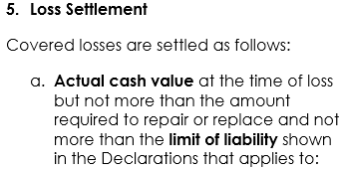
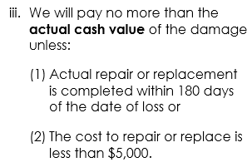
New RCV Form
New RCV form Loss Settlement provisions:
Co-Insurance clause is removed
Claims remain settled on an ACV basis (RCV loss less Depreciation)
Insured receives an initial ACV payment
Insured can recover depreciation withheld if repair or replacement is complete, or notification to MWUA of your intent to repair or replace the damaged or destroyed structure within 180 days of the date of loss.

Slide 56
RCV Form – Depreciation Holdback
Insured receives a Settlement Letter
Settlement Letter is sent to the insured that contains the following paragraph

Slide 57
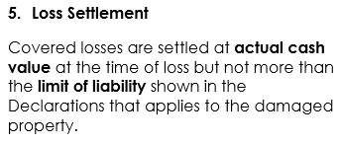
ACV form
New ACV form Loss Settlement provisions:
Claims are settled on an ACV basis (RCV loss less Depreciation)
Insured receives an initial ACV payment
There is no other recovery or follow up payment

Slide 58
Claims - What has happened in the past two years?
Hurricane Zeta – October 28, 2020
4658 claims reported
First real time test for Eberl Claims
Call center load issues
Claim examiner load issues
Handling claims during Covid – 19 lockdowns
First large claim volume with new RCV and ACV policies
Large number of roofs replaced
Many claims with recoverable depreciation/holdback taken
Claims remained open with remaining recoverable depreciation/holdback
MWUA RCV Policy allows 180 days to make claim for recoverable depreciation/holdback
Based on volume, supply issues, labor issues, an extension was granted April 2021
Three letters followed the initial settlement letter explaining the recoverable depreciation/holdback process

Slide 59
Claims - What has happened in the past two years?
Hurricane Ida – August 29, 2021
309 claims reported
Many had not reported Zeta claims
Declinations due to unrepaired Zeta damages
Second real time test for Eberl Claims

Slide 60
New Rule – Adding an Annual Inflation Guard
With MS Insurance Department approval and completion of Policy System Programming, MWUA plans to add a Dwelling & Mobile Home annual inflation guard process to new business & annual renewals (Does not apply to Commercial policies).
Reasons for implementing an annual inflation guard adjustment to policy scheduled limits before the rating factors are applied for premium quotation:
1. Material and Labor Costs are reaching high single to
double digit increases annually.
2. Inflation Guard being implemented to help policyholders
keep pace with inflation for coverage needs.
3. Helps prevent inadequate coverage for rebuilding at time
of loss.

Slide 61
Inflation Guard Continued
The target effective date is 4-1-2023 for Dwelling form policies (both RCV and ACV & dwelling/mobile home). The inflation guard adjustment factor will be determined once annually using the ISO/Verisk material and labor reconstruction cost reports for Mississippi (average of the most recent 4 quarter reports used as a guide for determination).
On first year implementation, a policyholder notice will accompany the first impacted renewal policy quotes explaining the policy building limits were adjusted by an X% inflation guard factor applied as the first step in the rating algorithm process for premium computation.
Example – expiring building limit $100,000, inflation guard factor 10%, adjusted limit is $110,000 subject to the current rating program in effect for the next term premium quote.

Slide 62
Inflation Guard Continued
New and Renewal policies will include an inflation guard endorsement that will provide the inflation guard adjustment factor for application to the next policy anniversary renewal quote. This means the issued policy will provide the next policy term factor one year in advance. Renewal quotes release 60 days ahead of policy expiration dates. The adjusted limit applies to the next term renewal policy and adjusts the limit effective the next anniversary renewal effective date.
MWUA will continue periodic renewal update site inspections
but will contemplate the upcoming renewal inflation guard
adjustment in the underwriting letter writing process when a
given risk appears to require a limit adjustment based on site
inspection.

Slide 63
Questions and Answers?
What are your questions regarding MWUA process and procedures?
What can MWUA do to improve operations?
Closing remarks
Thanks for attending this training session!!!

Slide 64
Thanks For Attending!!
Lee Harrell
MSRB Chief Executive Officer and Counsel
lharrell@msratingbureau.com
Brad Little
MWUA Assistant Manager
blittle@msplans.com
Kay Kayla
MWUA Underwriting Supervisor
kkayla@msplans.com
Paige Watson
MSRB Inspection Unit Supervisor
pwatson@msplans.com
Mike McGehee
MWUA Claim Manager
mmcgehee@msplans.com
Reg Ott
MWUA Coastal Services rott@msratingbureau.com

