Slide 1
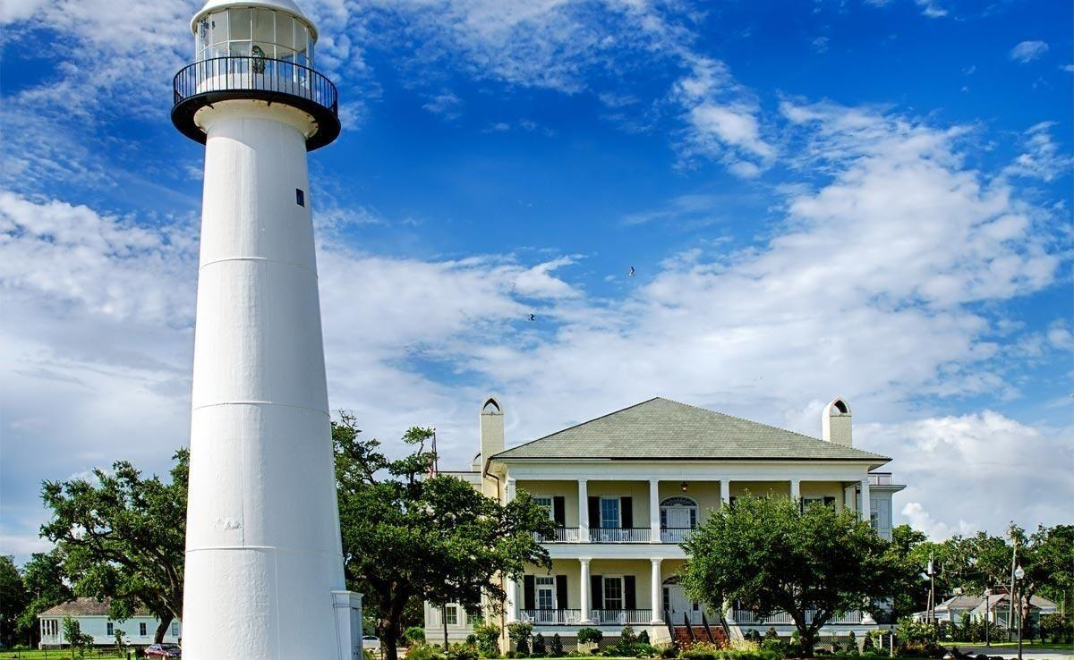
Mississippi Windstorm Underwriting Association
Commercial Application and Quote Processing

Slide 2
Commercial Applications – Things to Know
The Commercial maximum policy limit for any single building or building with contents is $1,000,000.
If the single building coverage intent includes contents, and the combined total value exceeds $1M, a single building blanket applies (more on blanket options later).
For each building or building with contents, if the total values are $1,250,000 or less the risk can be entered in the policy system at 80%, 90%, or 100% (based on limit vs total value).
For each building or building with contents, if the total values exceed $1,250,000 up to $2,000,000 the risk is entered as 50% coinsurance, a 1.5 multiplier is applied to the base rate in the policy system rating algorithm – coinsurance is suspended.
For each building or building with contents scheduled, if the total values exceed $2,000,000 the risk is entered as zero coinsurance, a 2.5 multiplier is applied to the base rate in the policy system rating algorithm – coinsurance is suspended.

Slide 3
Application of the % deductible
The percentage deductible is applied to the total values not the policy limit for each scheduled building, building with contents, or blanketed buildings or buildings with contents.
Examples:
Single building 2% deductible $1M policy limit, total building value $1.20M = $24,000 deductible
Single building with contents 5% deductible, $1M policy limit, total combined value $10M = $500,000 deductible applies. (note, since the total combined value is over $5M the 5% deductible is mandatory).
6 separate buildings for building coverage only combined in a single blanket schedule sharing a $1M policy limit, total value for each is $1.25M (6 X $1.25M = total blanket value $7.5M) requiring a minimum 5% deductible = $375,000 deductible. The ratio of policy limit to total value determines the coinsurance choice in policy system.
The total values are recalculated by MWUA claim at time of loss – while MWUA strives to check ITV when the policy is issued and on the new business site inspection, the claim adjuster determines the actual total value for application of the deductible at time of loss.

Slide 4
Commercial Blanket Options
Single Building blanket building and contents. A blanket would not be necessary if the combined building & contents values are less than $1M maximum policy limit but if over $1M must be a blanket.
Multiple buildings, or buildings and contents, sharing a $1M limit can be issued for buildings or buildings & contents at one location (same campus). It is also possible to break the same location/campus risks into separate blanketed clusters each with a separate $1M limit.
Multiple buildings or buildings and contents for multiple locations sharing a $1M limit can be combined for one blanket schedule. Only one multi-location blanket is allowed.

Slide 5
Things to know about Blanketing a risk schedule
Only MWUA can enter a blanket schedule in the policy system for quotation or issuance purposes. All non-blanket schedules should be entered in the policy system by the servicing agent. Mixed blanket and non-blanket schedules require servicing agent entry for non-blanket risks. MWUA underwriting enters the blanket schedules using the statement of values provided by the servicing agency.
The MWUA Blanket Schedule of Values form is required for risks that are blanketed.

Slide 6
A Properly Completed Statement of Values is Required for Blanket Schedules
Whether the blanket applies to one single building and contents schedule with total values above the $1M limit, multiple risks on the same location/campus, or multiple risks at multiple locations a statement of values is required. Again, only one multi location blanket is allowed by manual rules.
When completing the statement of values for a blanket policy, remember that the total blanket values determines the coinsurance that will apply. Any blanket sharing a $1M limit with total values above $1.25M up to $2M should be entered on the blanket schedule at 50% coinsurance, if higher than $2M a 0% coinsurance should be entered on the statement of values. Any blanket total values less than $1.25M can be entered on the statement of values as 80%, 90%, or 100% - there is a credit for 90% and 100% coinsurance, coinsurance penalties would be calculated by claims based on the option entered.
MWUA staff will suspense to require an updated statement of values 60 days in advance upon renewal.

Slide 7
Blanket Statement of Value requirements
For Blanket Limit Policies the MWUA Statement of Values spreadsheet is mandatory with application. All data columns on the spreadsheet should be fully & properly completed.
The scheduled risk values submitted to MWUA will be underwritten and site inspected to determine adequacy. Values should be submitted to MWUA accurately to avoid delays on application processing and/or post binding endorsed adjustments to limits or pricing.

Slide 8
Required information on Statement of Values
* The MWUA Statement of Values can be found on the MWUA website (application and forms section). It is required to log into the site as a first-time user to establish a user ID and Password – link to the website is https://msplans.com/ - use the agency/producer code for setting up access.
* Most of the columns on the spreadsheet are self-explanatory. Some clarification:
The building limit is a maximum of $1M between the building and contents column combined.
The total value should be the 100% Building and the 100% Contents values either RCV or ACV depending on the coverage intent. If there is no intent to cover contents leave that column blank.
Coinsurance should be entered according to the requirements based on total values explained on slide 6.
Blanket # applies to situations where the intent is to group buildings at the same location/campus into separate blanket coverages. For each building or building with contents enter the blanket # to confirm blanket coverage intent. Only enter a $1M limit for the first property in the blanket and enter “included” for the other buildings
If there is one blanket only use #1 for all scheduled and enter .
Any scheduled buildings not subject to the blanket with intent to insure on a “building by building” separate $1M limit basis would not have a blanket #.

Slide 9
Some of the Info Required on a Comm Application
Coverage cannot be bound if a high hazard flood zone applies (A, V, AE, AV etc.) and the flood coverage is not active or in place (this should be verified by the servicing agency to prevent E&O issues and/ or Claim declinations to the insured at time of loss for misrepresentation).
Special base rates apply to scheduled awnings, fences, sheds, etc. – for special type structures check with MWUA underwriting for coverage eligibility and classification.
Front and Back Photographs if each building or special type structure submitted for coverage must be provided with the completed and signed application to MWUA Underwriting. The photos should be current, minimum within 60 days of application effective date.

Slide 10
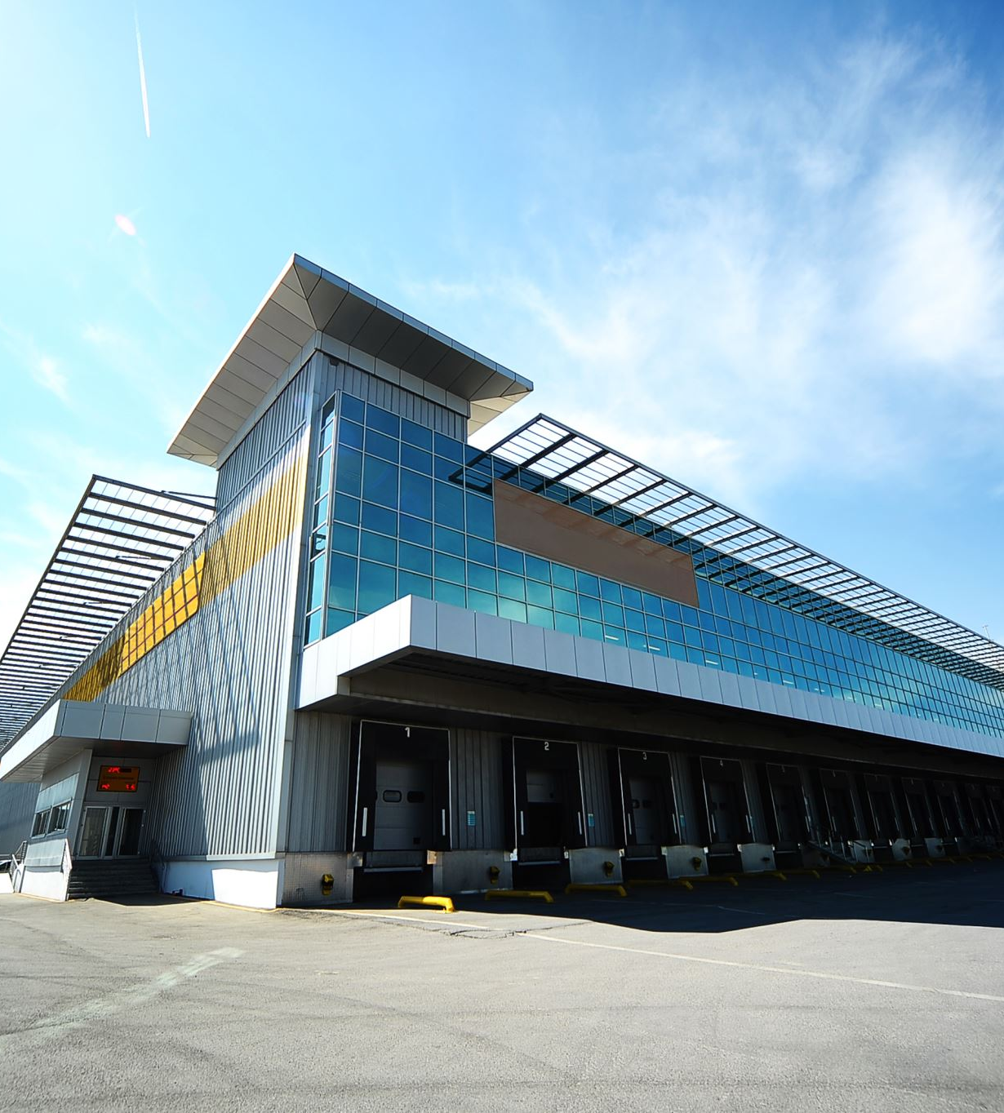
Other Commercial Facts
The Commercial Policy Service Fee is $40 per building subject to a maximum of $400 for buildings at any one covered location.
When a Commercial application indicates replacement cost in lieu of the base actual cash value coverage, a $50 fee applies per building, and insurance to value is underwritten on a replacement cost basis.
It is best to use the policy system link from the MWUA website https://msplans.com/mwua for access to the policy system. Reason, if you save the link as system updates are made the link you saved can be corrupted, not useable.
For a given building – the rating algorithm starts with the base rate X the rating zone modifier (if not zone A) X coinsurance multiplier X deductible credit X the BCEGS credit (if a valid C/O is provided).
MWUA underwriting determines a blanket average rate for multiple properties subject to a blanket schedule before applying the coinsurance multiplier, deductible credit, and BCEGs credit.

Slide 11
Commercial HABITATIONAL
Apartments with zero to four family are rated and issued on dwelling coverage forms.
MWUA can only cover exterior building coverage for specific units in an apartment building or townhouse building if the units are rated as a separate fire division (have firewalls and roof parapets allowing for a defined unit coverage approach).
If there are no firewalls/parapets all units must be covered on a combined Association basis for building coverage. Segments cannot be covered.

Slide 12
Commercial Habitational Cont.
Condo inside the unit Betterments and Improvements for specific units can be covered. If the occupancy is primary the coverage is issued on a dwelling form, if the occupancy is secondary/rental it is issued on a commercial policy form and rating basis.
“Association” covenants are required to help determine the insurable interest for individual unit owners, versus the Association interest. This is needed to determine intent/insurable interest that will be checked at time of loss adjustment before a claim payment. Only those buildings with separate fire divisions can be insured in segments within the total building.
Hotels/Motels classed as “extended stay” with less than 15% daily rental use are rated as habitational.

Slide 13
Commercial Rates effective 4-1-2024
Rating begins with zone A base rate (based on construction)
Frame – habitational 4.01, non-habitational 4.755
Masonry – habitational 4.01, non-habitational 3.796
SWR-A – habitational 1.923, non-habitational 1.416 (Must be Engineer certified)
WR-AA – habitational .969, non-habitational .947 (Must be Engineer certified)
Zone Multiplier – A 1.00, B .875, C .750, D .670, Barrier Island 3.50
Coinsurance Multiplier: (blanketing a schedule increases total value and multiplier)
Total values over $2M = 2.5
Total values over $1.25M up to $2M = 1.5
Others based on ratio of limit to total value 80% 1.00 factor, 90% .95 factor, 100% .90 factor
Deductible credits – 2% 1.0, 5% .87, 10% .78, 15% .71, 20% .65 (total values over $5M require minimum 5% deductible).

Slide 14
Commercial Rating Continued
BCEGS Classification is based on classification table as posted on the MSRB website and credit table from manual of rules and procedures. Commercial credit modifiers are .98, .94, or .90 based on BCEGS classification.
Rating Algorithm rate applies to limit per $100 (if $1M maximum apply rate to 10,000):
Base rate X zone X coinsurance X deductible X BCEGS (if applicable with valid C/O)
Example:
Frame Apartment – habitational – zone A – total bldg. values $3.5M (2% deductible) – policy limit is $1M maximum limit
4.01 X 1.00 X 2.5 X 1.00 = 10.025 X 10,000 = $100,250 premium (system will round differently but this will be close).
Add $40 per building for policy service fee capped at 10 per policy - $50 per building if replacement cost is chosen.

Slide 15
Commercial Rating Continued
There are commercial special rate classifications for unique structures/construction types:
Some “S” classification base rates examples (structures over water are not coverage eligible):
S73 – Awnings – cloth – 30.127
S75 – Fence – Wood – 30.127
S23 – Fence- Iron/Steel/Masonry – 3.246
S37- Church Sanctuary Frame – 5.180
S30 – Church Sanctuary Masonry – 4.720
S57 – Shed – 12.208
S85 – Frame Sign – 60.077
S67 – Metal/Steel Sign – 17.388
S57 – Open Canopy – 12.208
S29 – Playground Equip – 3.520

Slide 16
Guidewire Policy System
https://model-mwua.iscs.com/innovation

Slide 17
New Quote/Application Tips
Visit MSRB website (https://msratingbureau.com/) select GIS Location Information to obtain Flood Zone, Wind Zone, and BCEGS Community.
When Quoting, always use New Quote not Quick Quote.
When processing an application or quote ALWAYS HIT SAVE then next page. Save is your best friend. Please complete all information fields in the policy management system.
Review screen payment options are for how the insured wants to make payments in the future. ACH TRUST accounts are not recommended.
ACH applications must be signed/submitted along with the signed application emailed to mwua@msplans.com.
Log in to msplans.com and go to Policy System Tips for more helpful tips.

Slide 18
New Application Important Points
Effective Date – Not Bound until complete, paid, approved MW
Emergency Contact – Often skipped but important for claims
Flood Dec. Page – Required if risk is located in an A or V zone
Valuation Intent – RCV or ACV Choice Required
Agency – Servicing agent is not MW agent, resident license required
Binding provisions – Agent cannot guarantee binding effective date

Slide 19
Endorsements
Agency can add & delete mortgage companies, add loan numbers, and update mailing addresses.
All named insured signatures are required for decreases and name changes.
Billing screen shows all payments posted to the account and billing schedule for 4-pay policies.
History tab will show policy transactions.

Slide 20
Cancellations
Fully Earned Annual Premium Rule- 4 Exceptions
1. Wind & Hail coverage is placed with another carrier- Copy of the declaration page showing wind is included – required.
2. Property is sold- Copy of the signed HUD settlement statement or warranty deed is required.
3. Total loss on covered location.
4. Underwriting reasons other than non-pay.
All named insureds signatures are required on cancellations

Slide 21
All Checks must be made payable to MWUA
We will not accept A check made payable to the Agent/Agency even if agent has endorsed the back.

Slide 22
Reporting A Claim
Guidewire Policy system - Agents may use the Agent Portal to submit a Loss Notice. https://mwua.iscs.com/innovation
Phone - Call center is staffed by Eberl Claims Services 24 hours a day, seven days a week.
Claims can be reported by calling 1-866-634-4465
Email - newclaims@msplans.com or msclaimsdocs@msplans.com
Fax - New claims may be faxed to 1-877-786-7275
Claim Information brochure sent to insureds

